Slide 1



Temporal and spatial heterogeneity of forest loss in Myanmar
David Klinges IX
Notes:
My time here has been primarily concentrated on contributing to our NASA-funded research in Myanmar
SCBI has been working in Myanmar for 30+ years
Touches upon many of the strengths and tools that the lab possesses
I’ll start with background on the country
Then overview of the project
Narrow in upon my role in this ongoing research

Slide 2

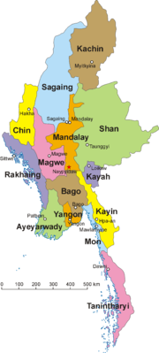
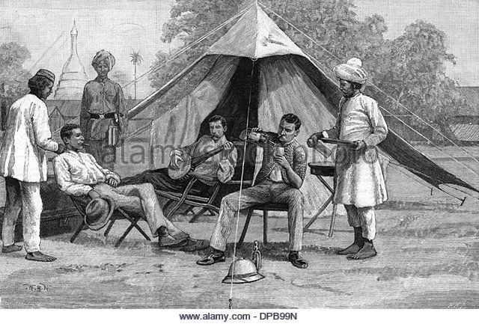
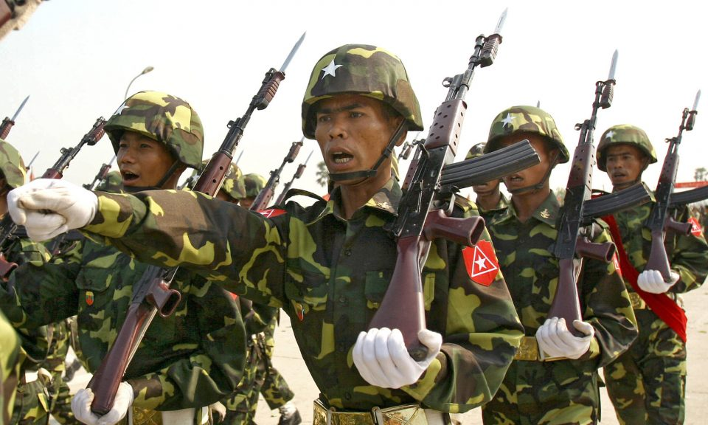

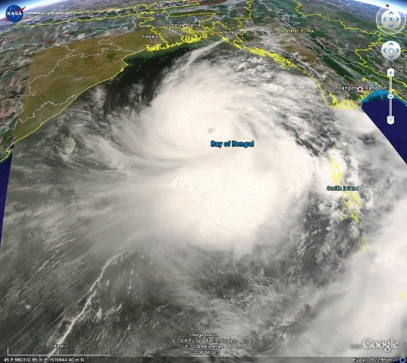
Myanmar at Large
Notes:
History of Myanmar
British colonial rule
Unbalanced society: concentration of wealth and status
Military rule
For the 2nd half of the 20th century
Cultural Strife/Human Rights Crimes
Police and military brutality
Forced labor
Genocide of cultural minority, Rohingya
Natural Disasters
Cyclone Nargis: suspected to have killed 130,000, damages $10 billion, 1 million left homeless
Opposition to Foreign Aid
gov’t prevented assistance from large-scale internat’l aid after Nargis
Failed Democracy
Still centralized power, military retains quota of power
Several delayed or otherwise cancelled attempts at forming a democratic constitution
Fair amount of public support for authoritarian rule and ethnic cleansing
Massive support for “democracy,” but little support for the liberal tenants of democratic values and platforms
Imprisonment of journalists, etc.

Slide 3
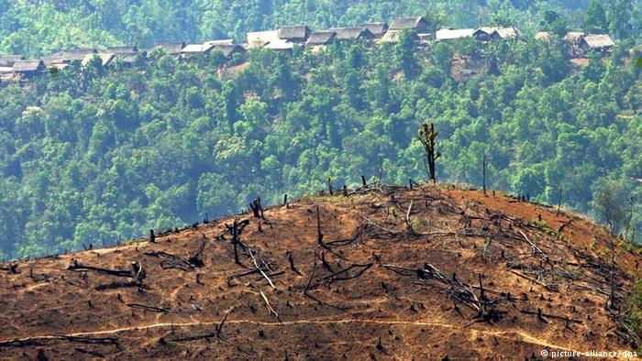
Deforestation in Myanmar
One of the most forested countries in Asia
Minimal deforestation between 1990 and 2000
Notes:
Late 20th, early 21st: deforestation minimal compared to Brazil, Indonesia, Central Africa, etc.

Slide 4
Deforestation in Myanmar
Deforestation rates may have doubled in past decade
Political and social drivers of forest decline
“Natural experiment”: abrupt change in amount of development
Notes:
Deforestation may have doubled in past decade
From a theoretical perspective: Myanmar’s rapid sociopolitical overhaul offers a “natural experiment” of sort
Since Myanmar’s President U Thein Sein took office in March 2011, the new reform-minded government has promoted industrial agricultural development as an attractive sector for both domestic and, increasingly, foreign investment
The remaining natural forests in the country’s resource-rich, ethnic-populated states are still left outside any effective forest management and are thus even more prone to extensive logging and forest conversion. (Woods 2015)

Slide 5
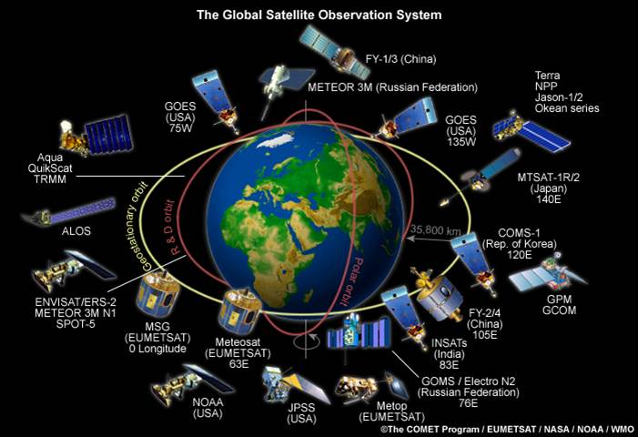
Methods of Remote Sensing
Challenge: Differentiating standing forest and commercial plantations
Challenge: precision/high resolution
Notes:
Our work involves using remote sensing to quantify changes in land cover and land use
But there are some inherent challenges to this process

Slide 6

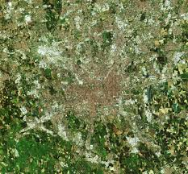
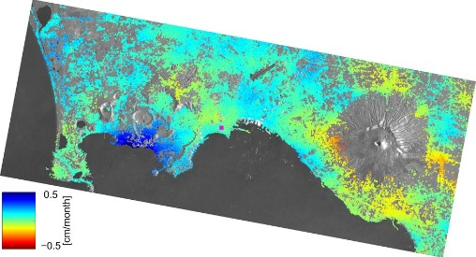
Methods of Remote Sensing
UAV
- Energy and budget intensive
- High resolution
Multifaceted Surveillance
Satellite: passive
Satellite: Active
- Publicly available
- Low resolution
Notes:
How to overcome such challenges: synthesis of methods
Satellite: passive (optical) and active (radar) can track both spectral and structural change
- Cover classification and intensity
UAS: high resolution for understanding on local scale
- For forest loss, impt cuz some deforestation occurs on single landowner scale
Multifaceted Surveillance
Build an algorithm that incorporates data from all of these types of data for an improved image of land classification/deforestation rates

Slide 7

.
3. Sociopolitical Drivers, Impact of Deforestation
2. Forest Cover/ Deforestation Mapping
1. Forest Type Mapping
Deforestation analysis
Conduct field interviews
Ground truthing
Remotely sensed classification
UAV protocol
Acquire Sentinel, PALSAR, ASTER data
Data collection via UAV
Annual forest cover mapping
*
*
*
Annual forest cover mapping
Notes:
Project objectives:
- Map forest cover and land use change, especially in relation to commercial (plantation) agriculture and armed conflict
Forest Type Mapping
Field data collected on foot
Preliminary land classification via (satellite?)
Establishing the drone protocols via flights here on campus
Forest Cover/Deforestation mapping
Bulk of data collection: different satellite types
Also drone imagery
Sociopolitical Drivers
Analyze deforestation data: what regions/townships are most under threat? Which have had stable forest coverage?
Toss some social scientists into the field because they know how to work with people
How I fit in:
(icon of me)
Some involvement in ground trothing, UAV protocol construction, data collection….
But the bulk of my products are related to deforestation mapping
Primarily: compiling, organizing and analyzing remotely sensed data

Slide 8
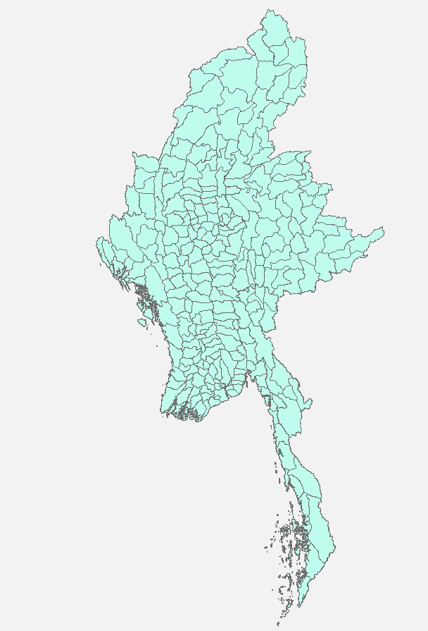
Country-Wide, Township level
- Forest Cover
- Forest Fragmentation
Localized Focus
- Development is irregular
Notes:
Why look at forest loss on the township level?
What is the legal definition/implications of a township in Myanmar
Logic of observing high-resolution/localized loss:
Federal involvement in development is irregular, some areas receive far more attention than others
Local governance plays a large role in agricultural systems and resource availability
Agricultural practices localized

Slide 9



Data Compilation
Processing
Analysis
Hansen: 2001- 2016
Forest loss + fragmentation @ township level
Notes:
Brief overview of workflow:
Variety of spatial tools
Compilation: Use of LANDSAT imagery, and we’re using Hansen 2016 forest cover from 2001-2016
Processing: subset to township level, record forest loss and fragmentation
Analysis: comparison of spatial and temporal changes

Slide 10
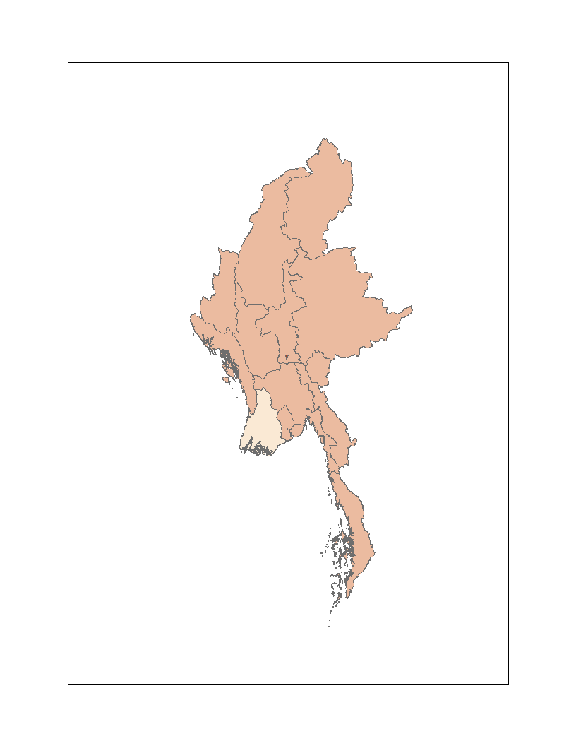
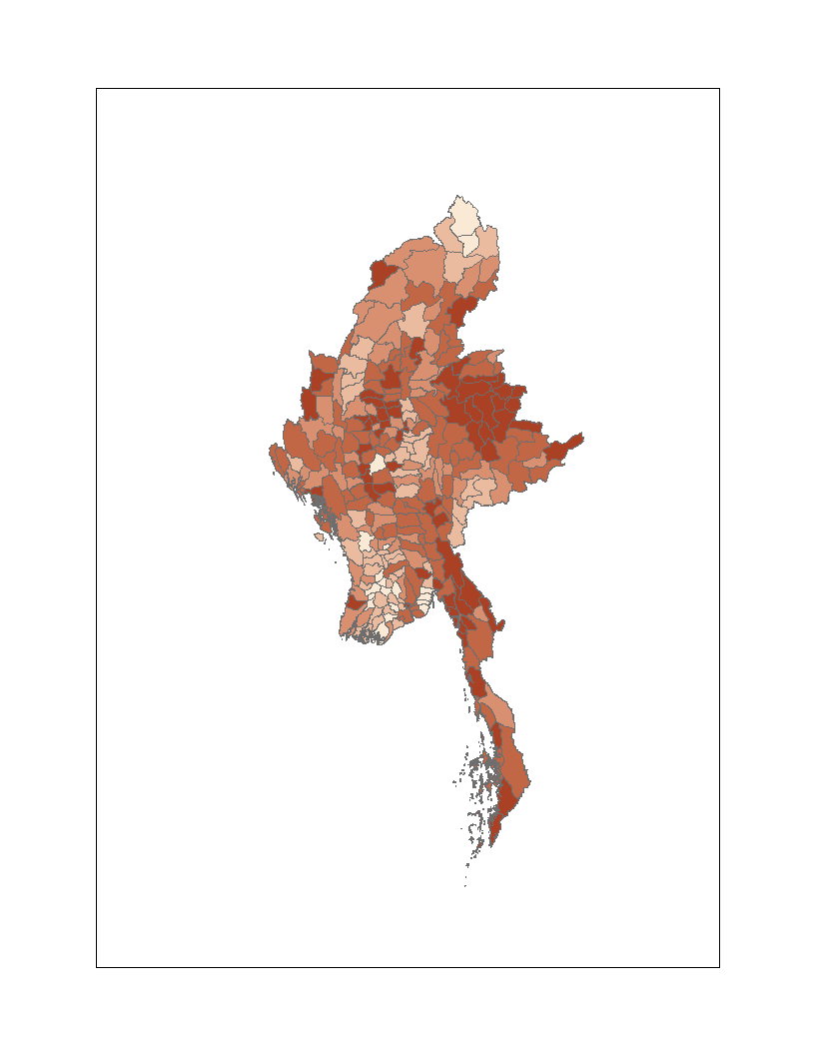
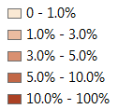
Forest loss is spatially stratified
Region | % Loss
Ayeyarwady | 0.131
Bago | 0.260
Chin | 0.465
Kachin | 0.273
Kayah | 0.413
Kayin | 0.658
Magway | 0.762
Mandalay | 0.406
Mon | 0.931
Naypyitaw | 11.6
Rakhine | 0.338
Sagaing | 0.865
Shan | 0.616
Tanintharyi | 0.638
Yangon | 0.248
Notes:
Local stratification of forest loss: heterogeneous distribution

Slide 11
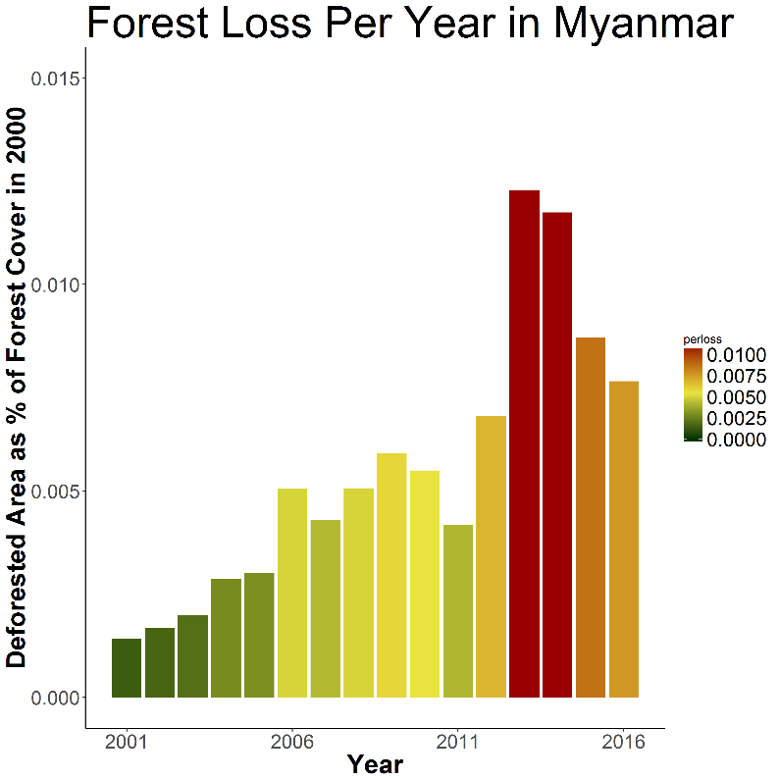
Forest loss changes over time
Notes:
Line corresponds to new governmental regime
Corresponds with when President U Thein Sein took office in March 2011
Sharp increase in forest loss in 2013

Slide 12
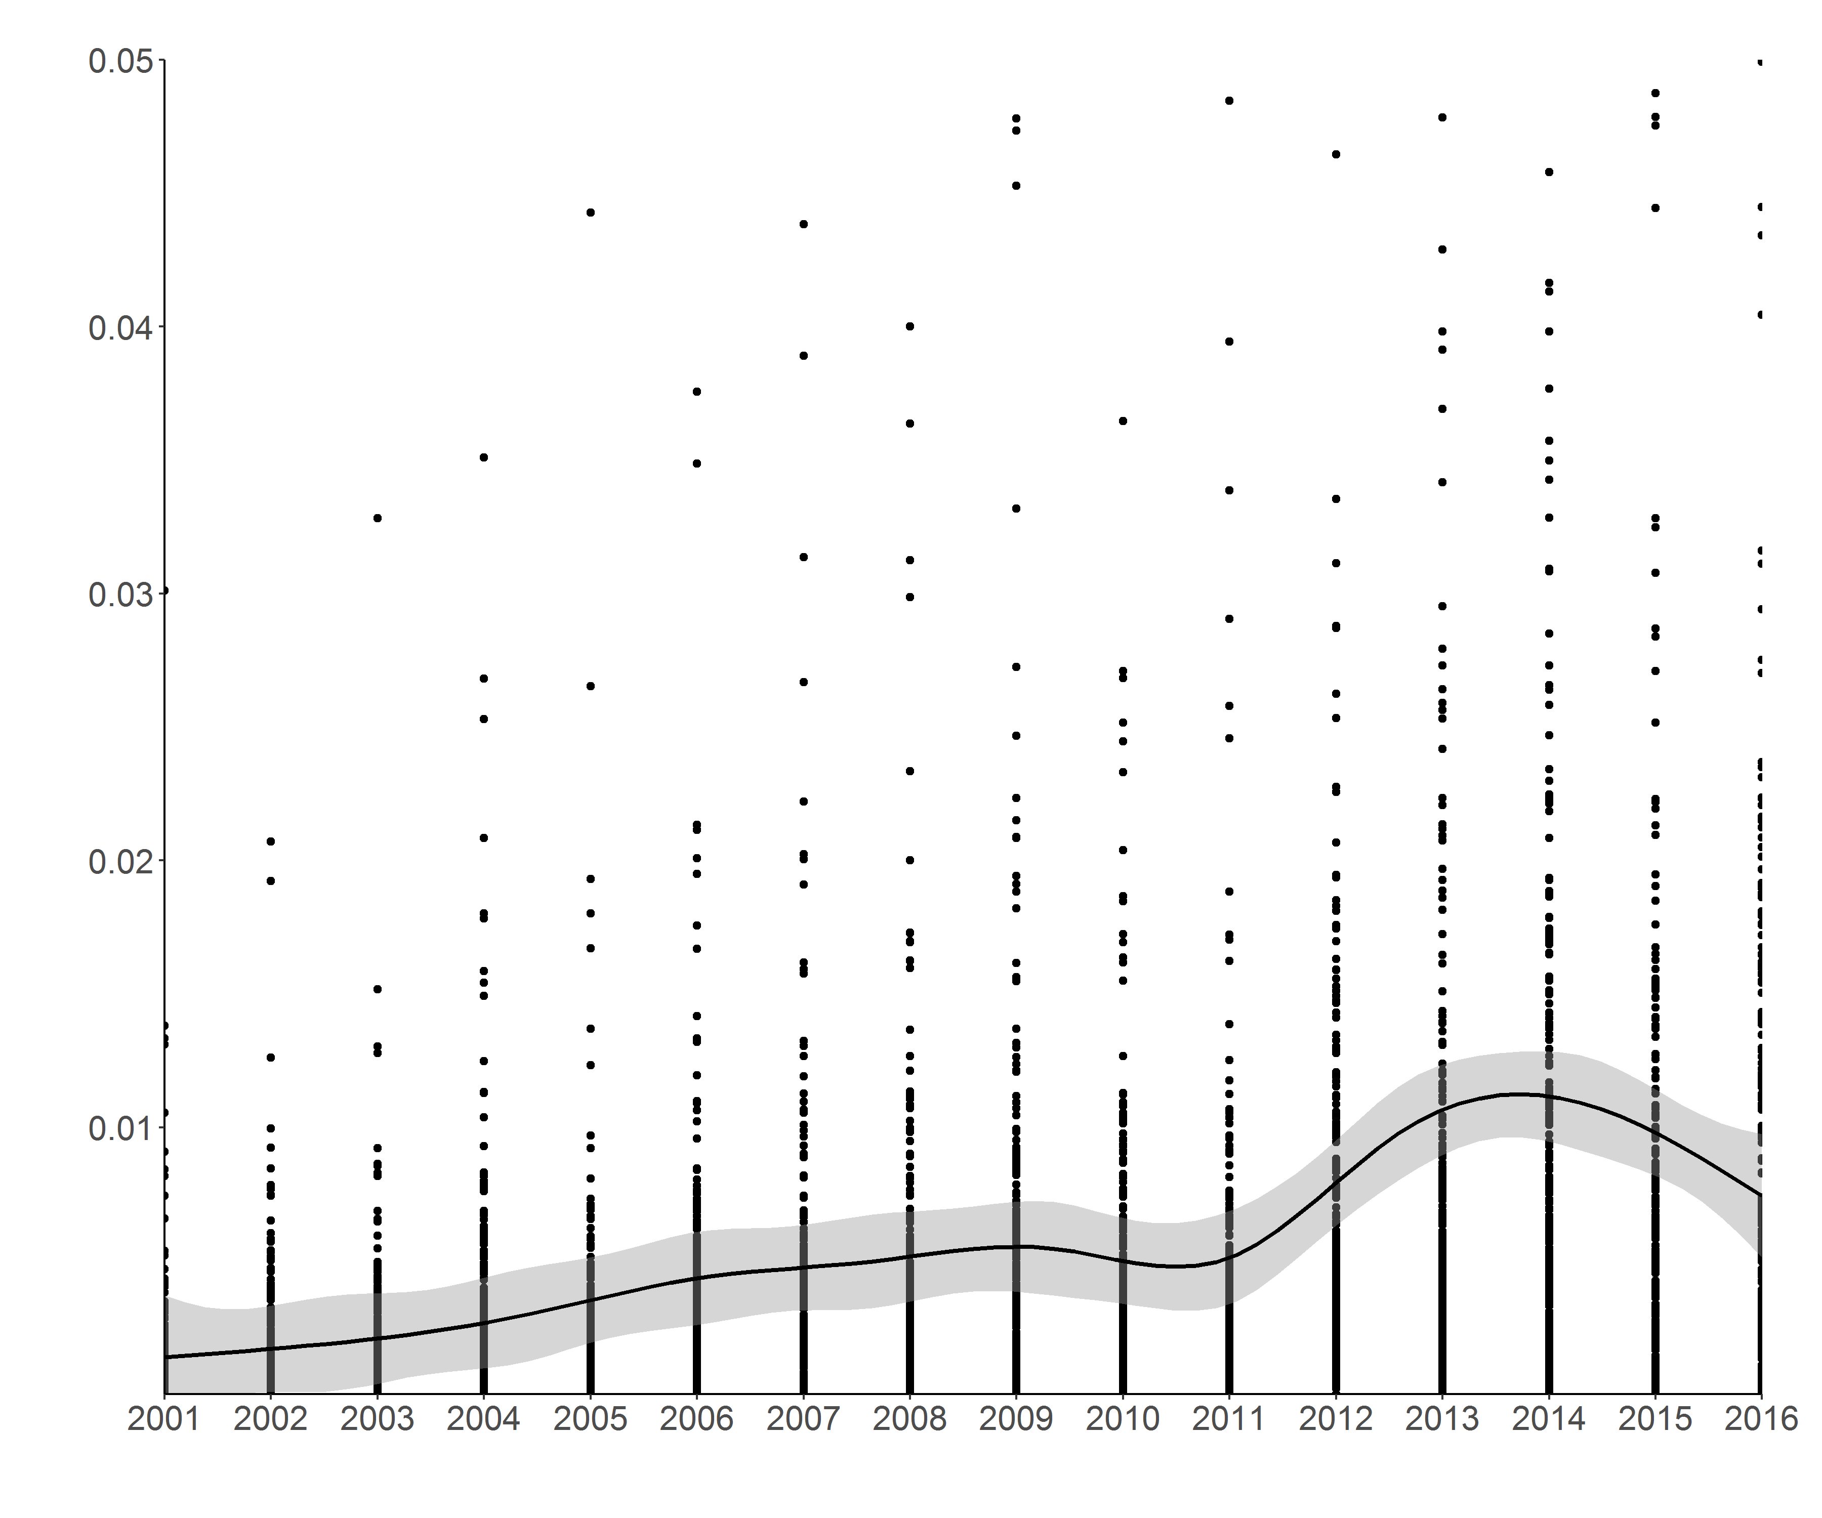
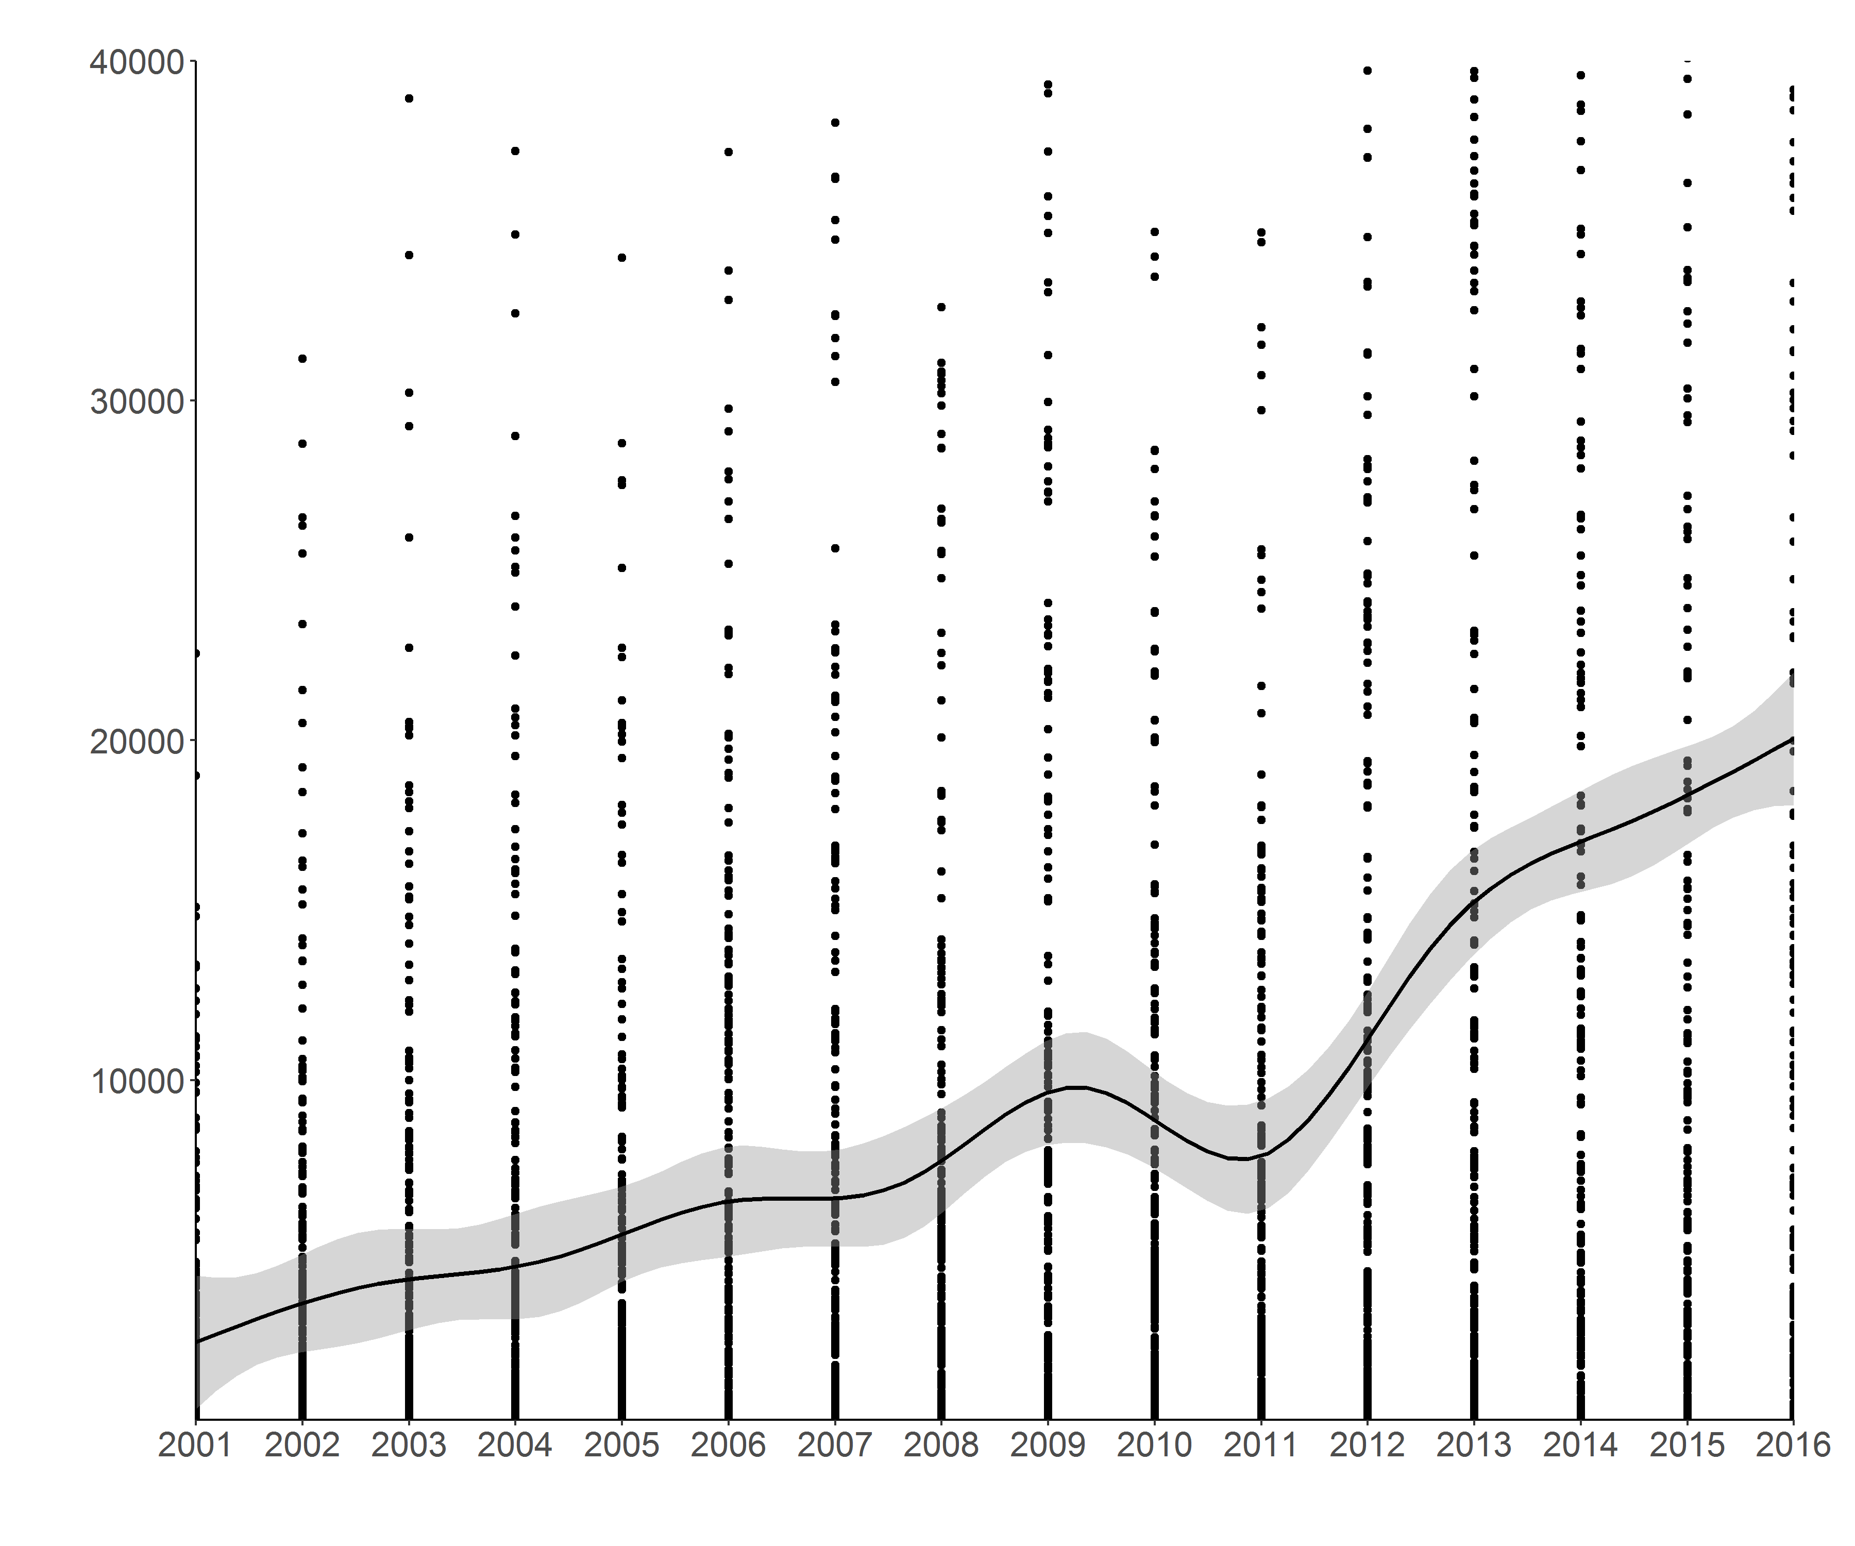
Forest loss changes over time
Percent Loss
Absolute Loss
Notes:
Sharp increase in 2013

Slide 13
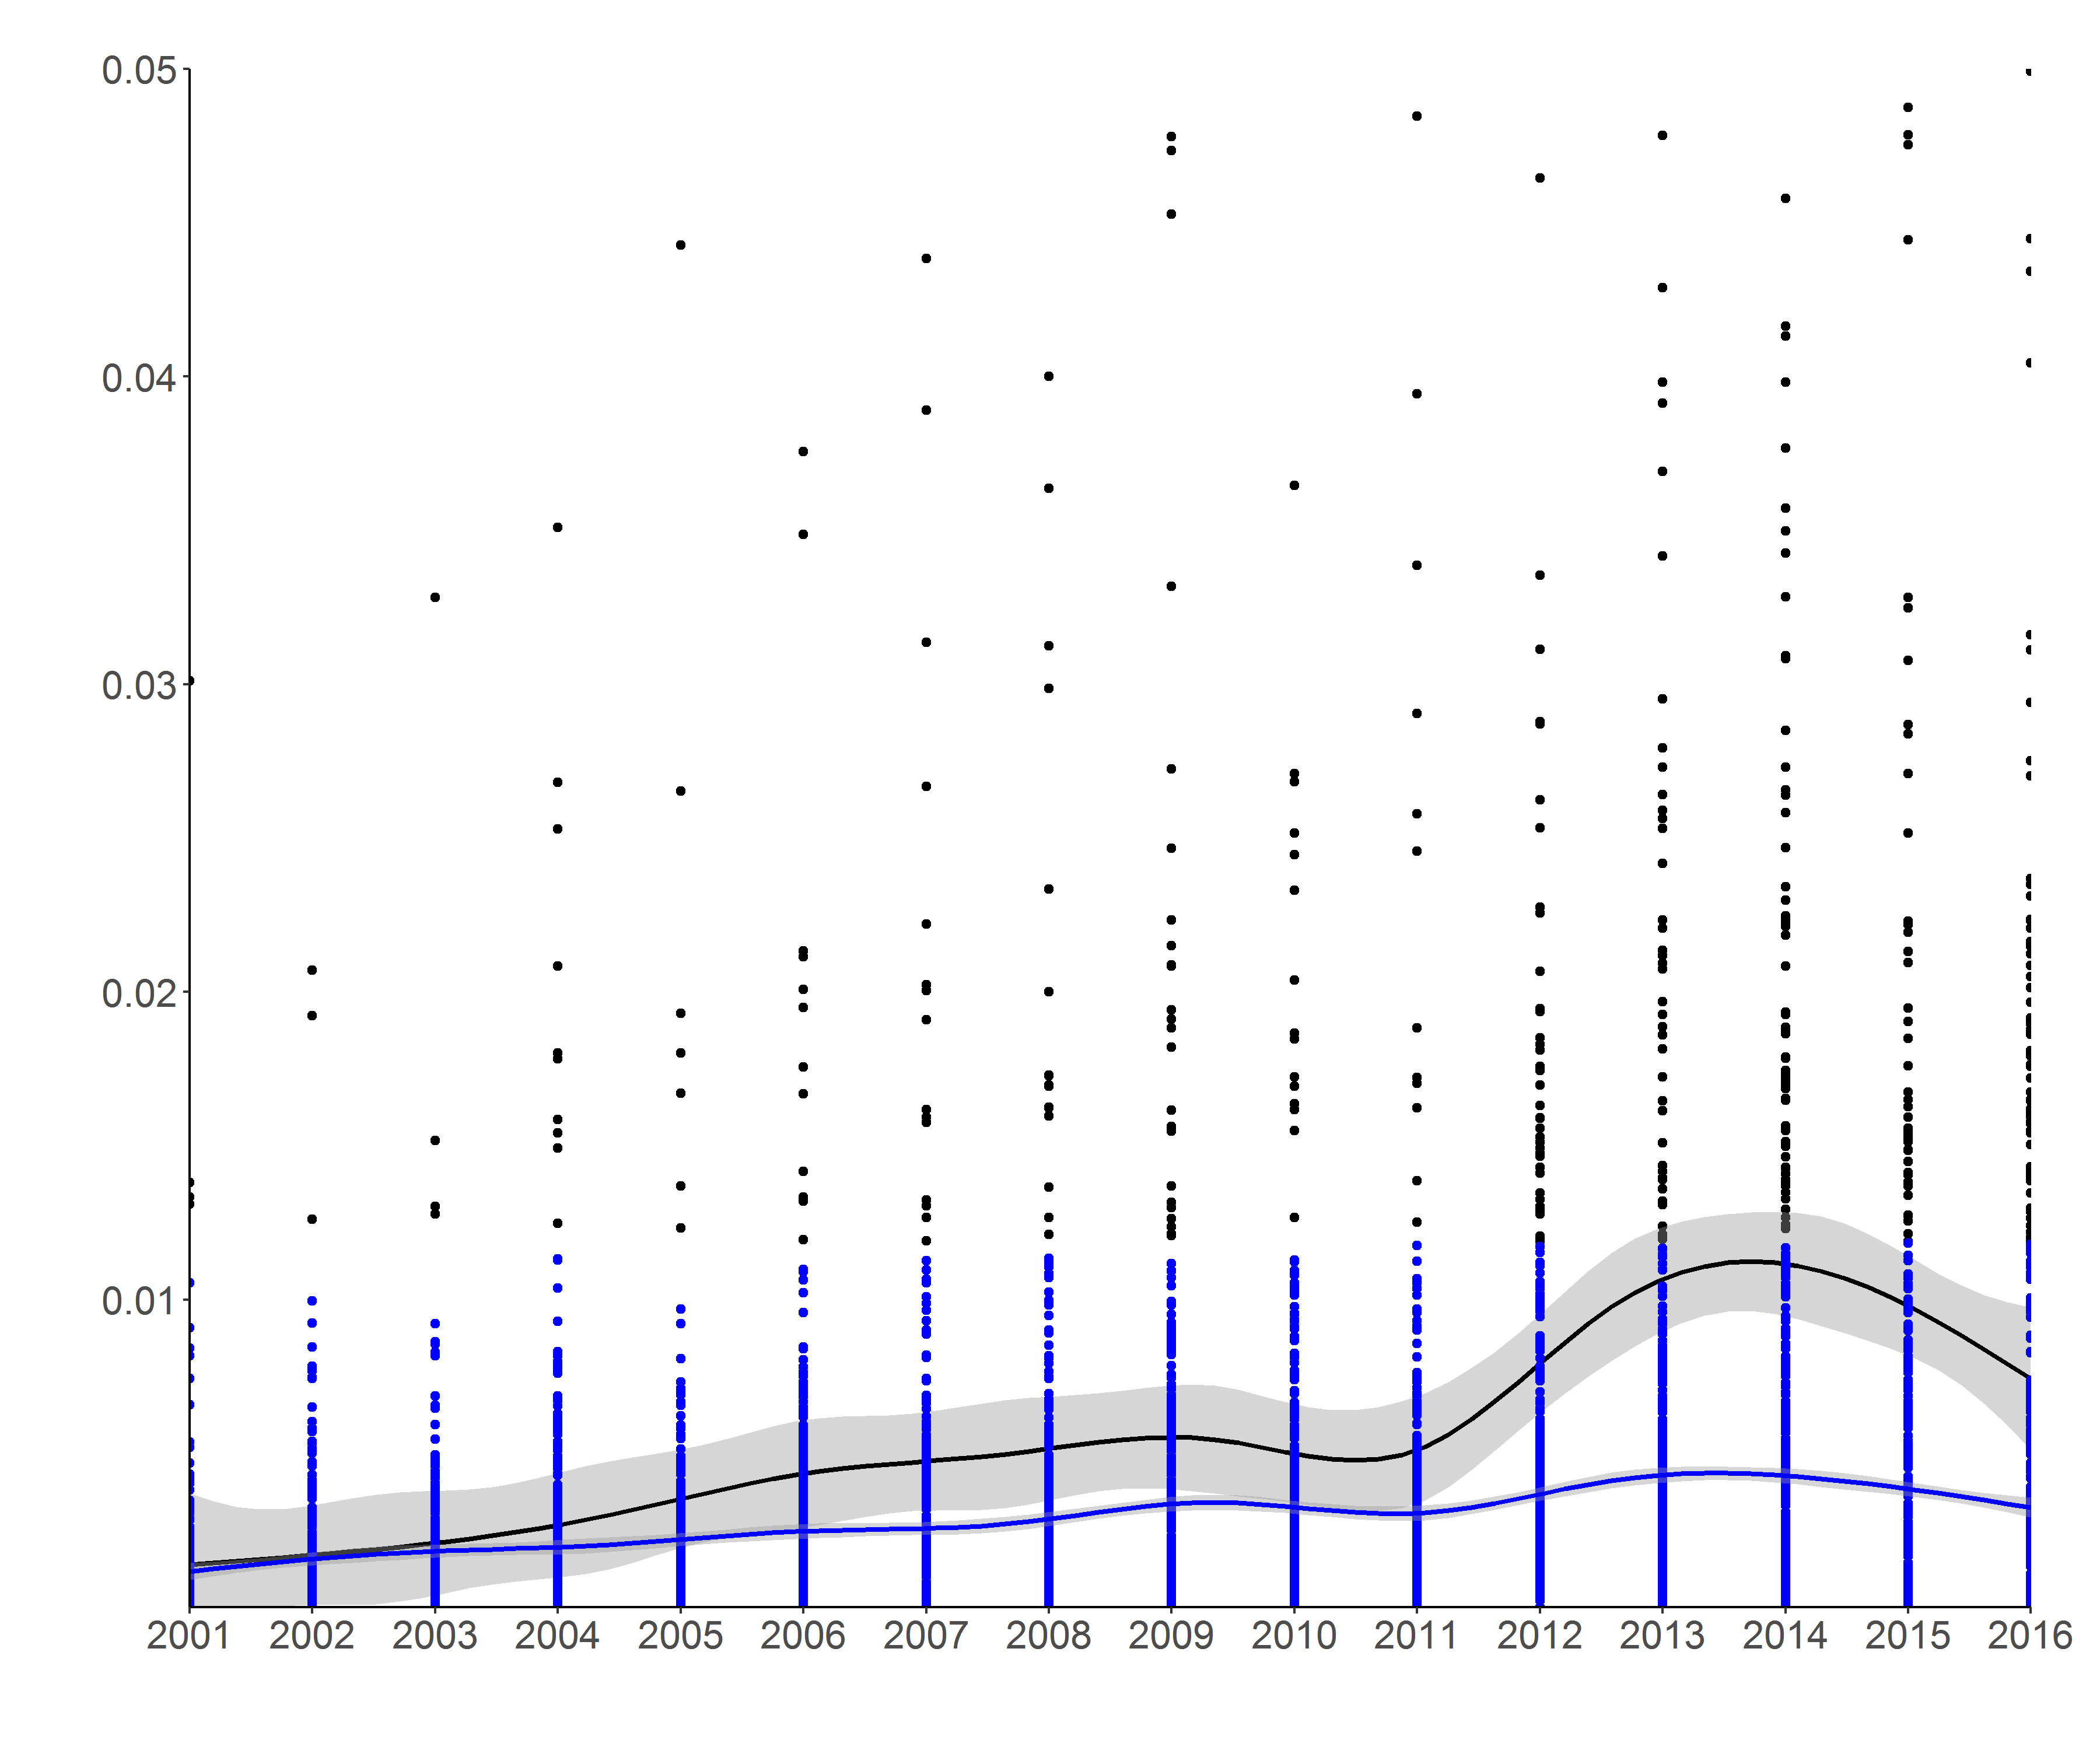
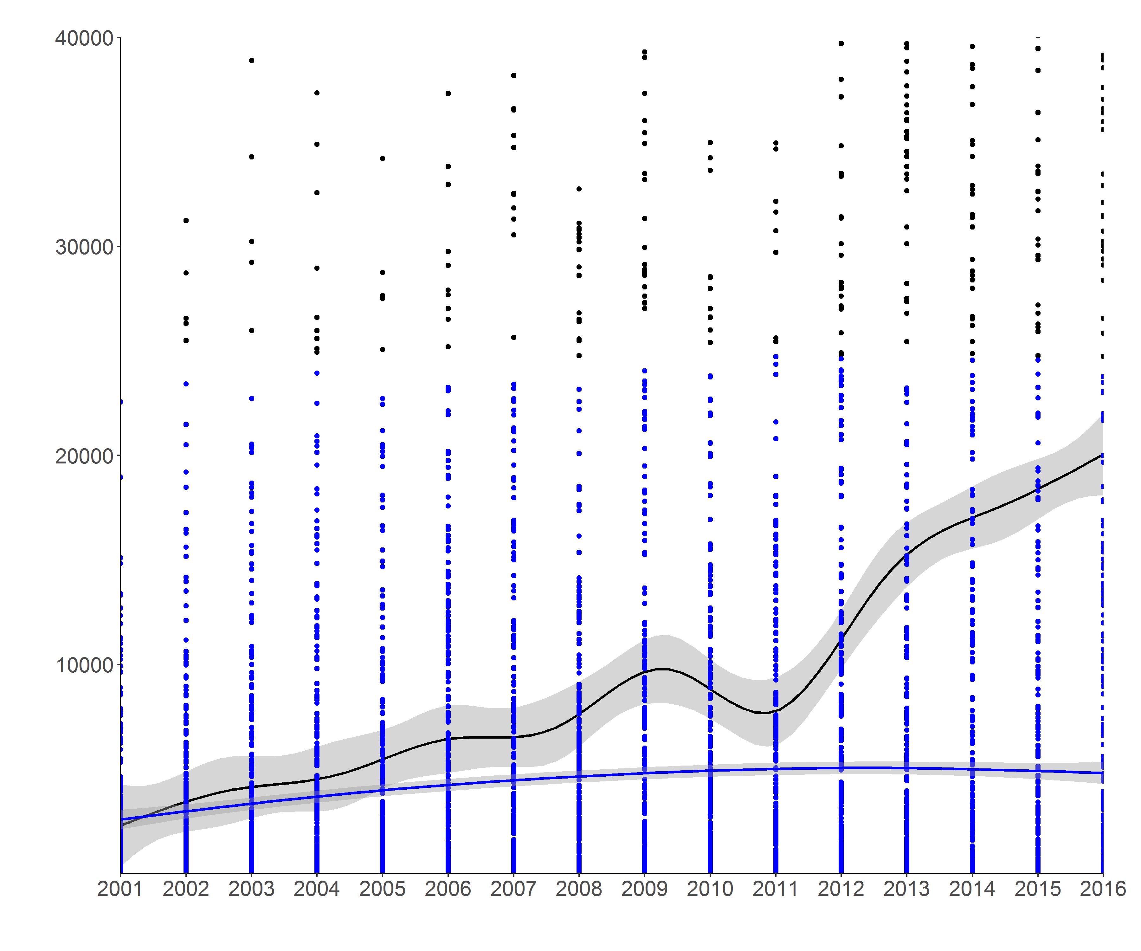
Forest loss changes over time
Chi-squared = 5108.7, p < 0.001
Chi-squared = 73.379, p < 0.001
Percent Loss
Absolute Loss
Notes:
Increase in deforestation concentrated in select townships
When distributional outliers are removed:
*outliers calculated by statistical definition: greater then 1.5 * the IQR

Slide 14
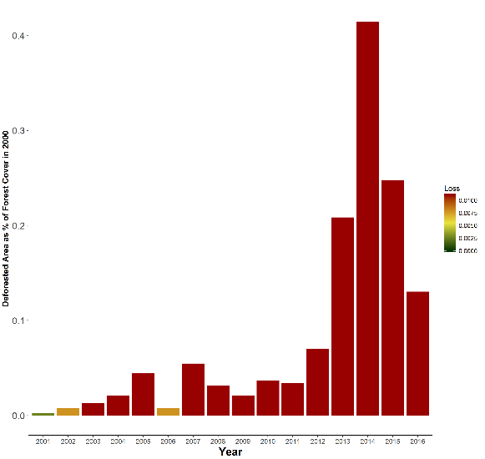
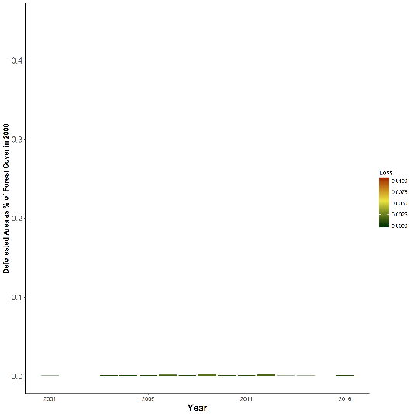
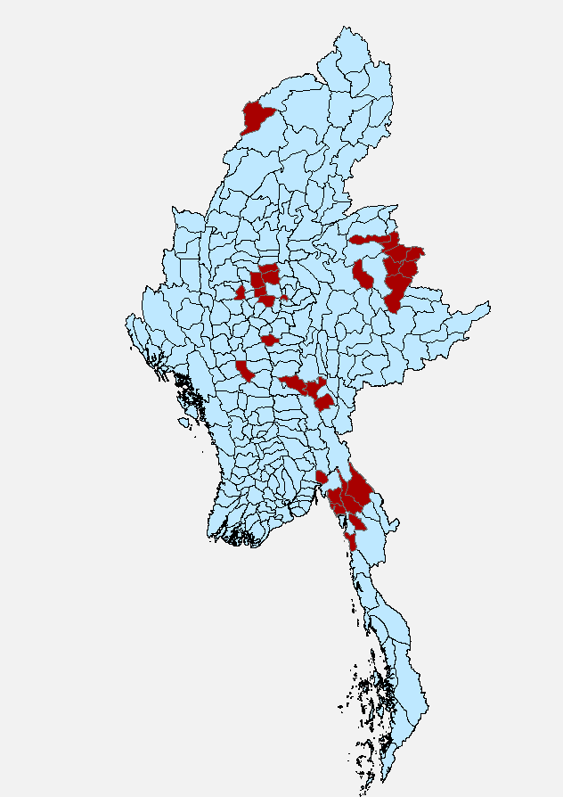
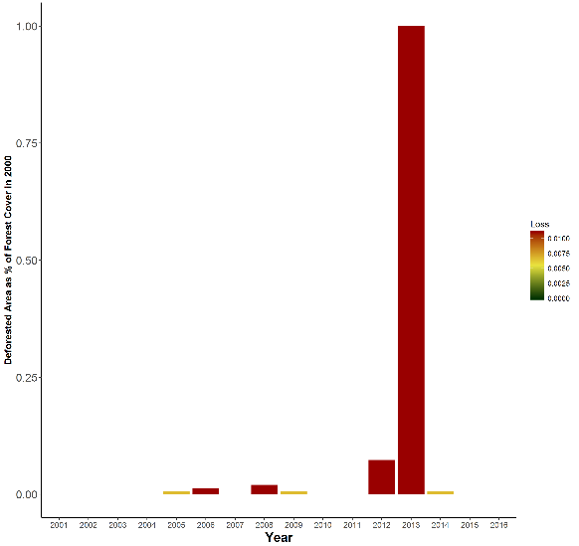
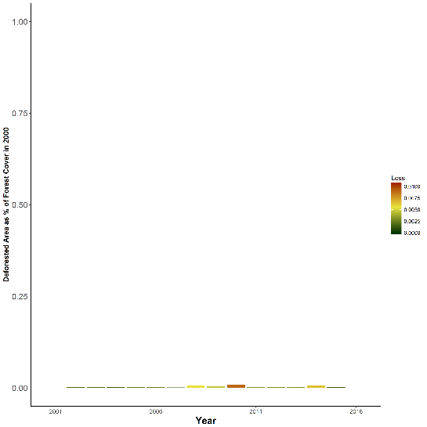
Ayadaw
Mingin
Magwe
Sinbaungwe
Notes:
Comparison of High-loss towns to neighboring townships
(Apologies for the tiny axes, and non-existent bars….but these are standardized axes
45% and 100% forest loss
So yes, did not include regrowth in quantifications
clearing of forests to make way for the expansion of commercial agricultural fields is increasingly the leading driver of deforestation,
alongside legal and illegal logging, and the clearance of forest areas to make way for infrastructure projects such as roads and hydropower dams
(Woods, K. 2015. Commercial Agriculture Expansion in Myanmar: Links to Deforestation, Conversion Timber, and Land Conflicts.)

Slide 15
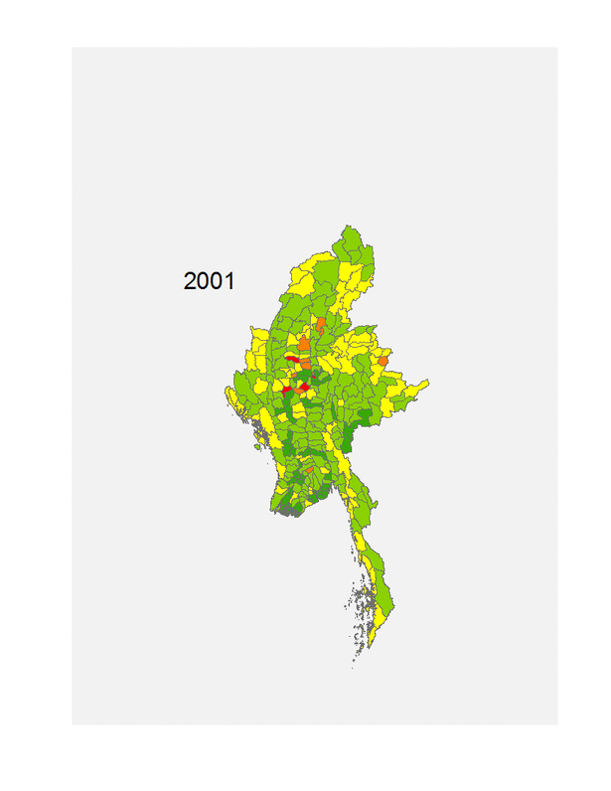
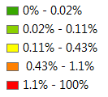
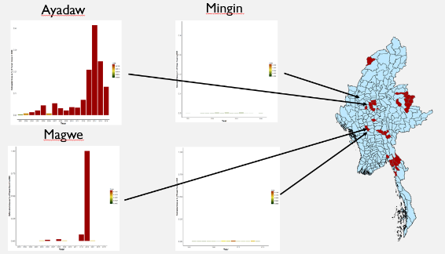
Spatial and Temporal Heterogeneity
Proximity to roads?
Federal support?
Distribution of Data
% Forest Loss
0- 10th percentile
10th- 30th percentile
30th- 70th percentile
70th – 90th percentile
90th-100th percentile
Notes:
Therefore, when spatial and temporal components are combined, we have a broader picture of deforestation dynamics in Myanmar
Quick visualization of both spatial and temporal dimensions of forest loss
Data = annual forest loss in each township
Legend: include labels of percentiles
Displayed data is % of forest cover in year 2000 lost
Breaks at 10th, 30th, 70th, 90th percentiles of data

Slide 16
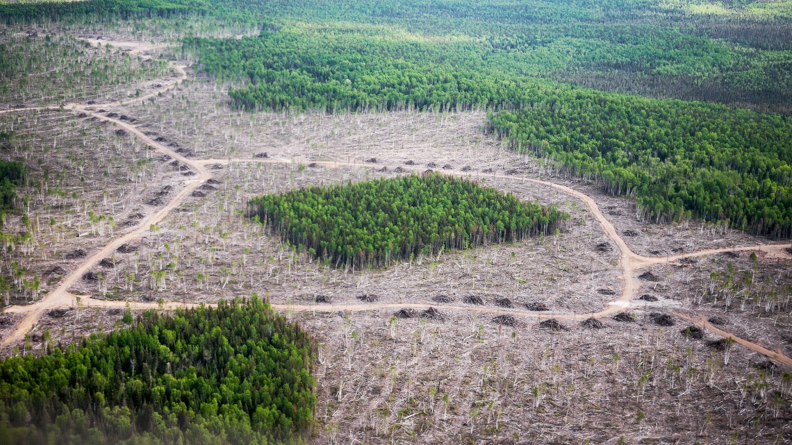
Forest Fragmentation
Notes:
Didn’t get a chance to peel back fragmentation results much
Forest loss is a metric that is easy to wrap one’s head around…but fragmentation is, in many ways, more biologically and ecologically significant
Habitat connectivity: megafauna SOI’s necessitate large connected forests
Socioeconomic contributions to fragmentation, how frag can enlighten methods of deforestation
Scale of deforestation: is forest loss occurring on a small scale (family farms), or commercial?
Methods of forest loss: patchy and stratified, or large patches of deforestation?

Slide 17
Forest Fragmentation: Habitat Connectivity
Notes:
Didn’t get a chance to peel back fragmentation results much
Forest loss is a metric that is easy to wrap one’s head around…but fragmentation is, in many ways, more biologically and ecologically significant
Habitat connectivity: megafauna SOI’s necessitate large connected forests
Socioeconomic contributions to fragmentation, how frag can enlighten methods of deforestation
Scale of deforestation: is forest loss occurring on a small scale (family farms), or commercial?
Methods of forest loss: patchy and stratified, or large patches of deforestation?

Slide 18
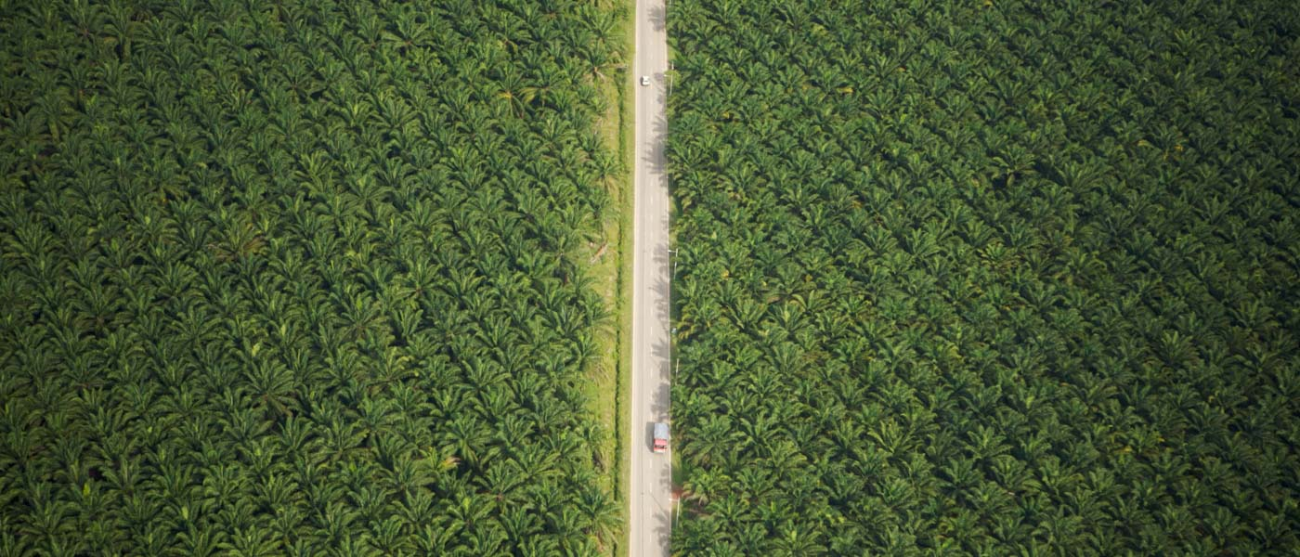

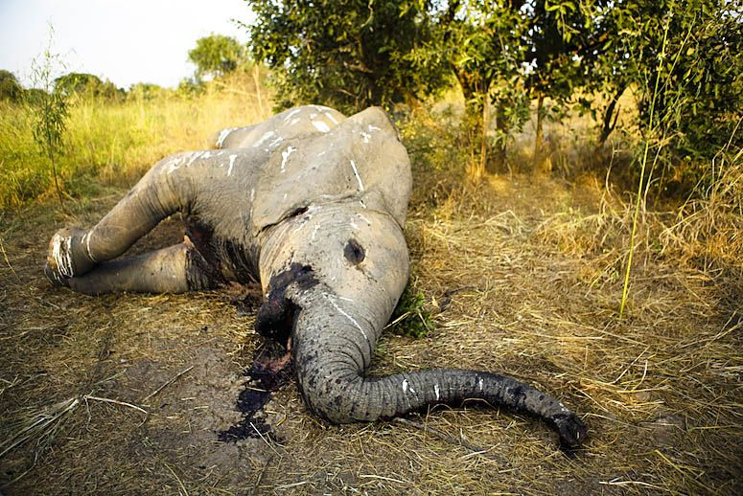
Driver: roads, agriculture
Federal involvement in development
Understanding of local trends in poaching
Notes:
Further Work:
Drivers:
Commercial agriculture: rubber, palm oil, teak
Like almost all research, we end with more questions than when we started
I would be interested in having these concepts explored:
Proximity to roads, facilitates large-scale agriculture and external investment
Federal involvement
Extent of poaching
Interviews: understand underlying drivers of deforestation on local level
Consistent forest loss after 2010
Surprising that Kachin (near Chinese border) has low forest loss
A handful of dynamic township figures
Poaching: like forest loss, is spatially heterogeneous/stratified. What regions or townships in Myanmar are most under threat?
Interviews in highly forested tonwships, country-wide

Slide 19
Acknowledgments
Qiongyu Huang, Sumalika Biswas
Conservation GIS Lab
Smithsonian Conservation Biology Institute
Notes:
Qiongyu and Sumalika….
Interns and post-docs: Audrey’s coding prowes….
This lab and campus facilitates collabs and interactions….nice environment for interns….

Slide 20
Sources Cited
Giri, C. et al. 2011. Status and distribution of mangrove forests of the world using earth observation satellite data. - Glob. Ecol. Biogeogr. 20: 154–159.
Hansen, M. C. et al. 2013. High-Resolution Global Maps of 21st-Century Forest Cover Change. - Science 342: 850–853.
Leimgruber, P. et al. 2005. Forest cover change patterns in Myanmar (Burma) 1990–2000. - Environ. Conserv. null: 356–364.
Woods, K. 2015. Commercial Agriculture Expansion in Myanmar: Links to Deforestation, Conversion Timber, and Land Conflicts.

Slide 21
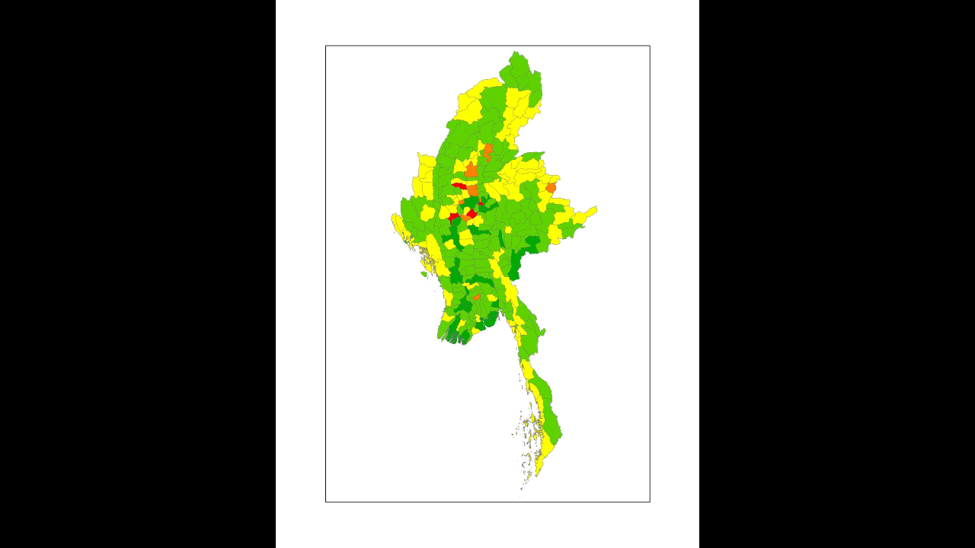
Notes:
Important figures

Slide 22
Revision and Synthesis of Data: research isn’t conducted just once
Science as a multidisciplinary process
Collaboration is Key
Notes:
Revisions to and synthesis of previously collected data
This project can be equated to a “literature review” of data collection: synthesis of various forms of data to form a more comprehensive image
SI has been monitoring forests in Myanmar for decades. But this work is more culminating in nature
Inform our understanding of ecological + sociological dynamics, and interactions
Science as a multidisciplinary process
Correlation vs causation
Quantification of forest decline is helpful. Puts the extent of threats to the region into context. But associating land use changes with social and political factors helps target and understand the sources of threats themselves
Collaboration is key
All in this room, including us humble interns, are aware of this. But the extent of collaboration is not always apparent, and in large collaborations the mantle of initiative is not always apparent or heavily dispersed.
Some reflections on this
Collaborative efforts move slowly

Slide 23
Q’s Going Forward
Proximity to recently developed/paved roads?
What townships were provided with more federal involvement?
Extent of poaching on a township/regional level?

Slide 24
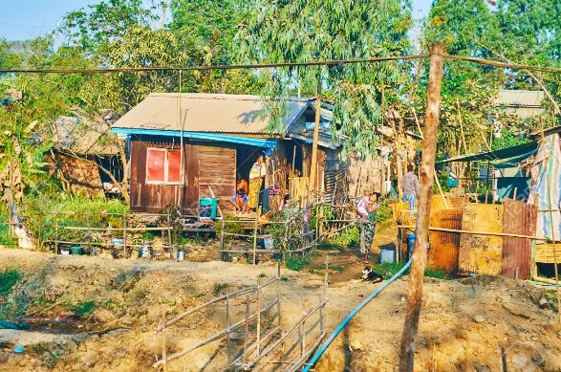



Drivers of Forest Loss
Land Tenure Insecurity
Low Governance capacity
Demography
Civil War
Notes:
Land tenure insecurity:
No property rights = no attachment to land
Reduces incentives for long-term/sustainable land use
On a global scale, correlation with high rates of forest loss (Robinson et al. 2014)
Demography:
- Increasing population

Slide 25
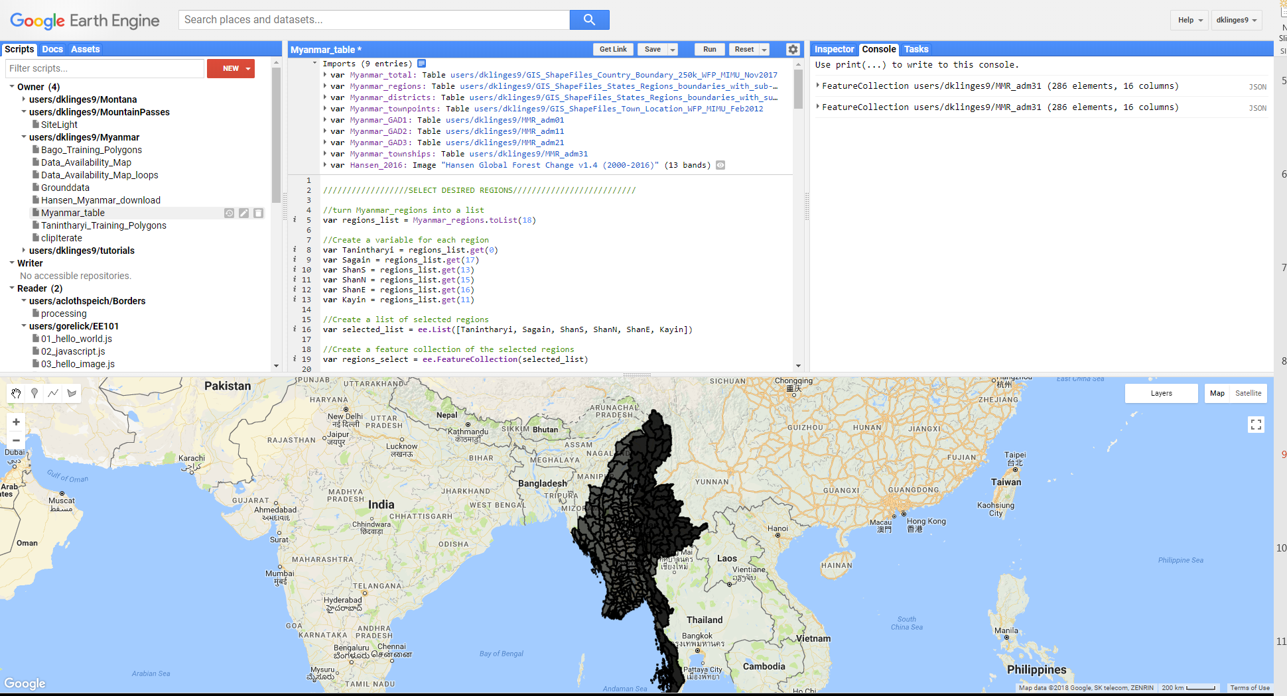

Slide 26
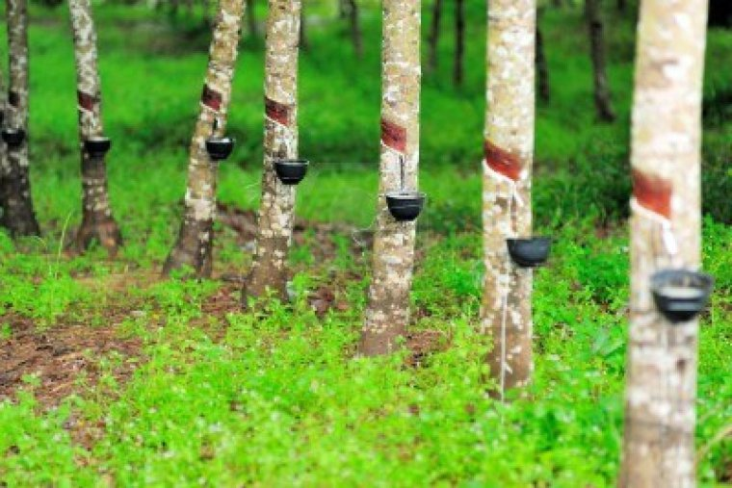
Commercial agriculture: rubber, palm oil, teak

Slide 27
Drivers of Forest Loss
Commercial agriculture: rubber, palm oil, teak
Commercial agricultural expansion in Tanintharyi, etc….where forest loss is highest
Notes:
Since 2010, the political and economic reforms resulting from the democratization process have significantly increased the country’s access to global markets, and resulted in an influx of international aid, trade, and investment.

Slide 28
The NASA-LCLUC Program

Slide 29
